Slide 1

Prediction Model
(Airbnb Prices in Amsterdam)

Slide 2
Introduction
This presentation will cover the development and implementation of a machine learning model to predict Airbnb prices in Amsterdam. The model was built using Python and scikit-learn and was trained on a dataset of Airbnb listings in Amsterdam. The goal of this project was to provide a model for both Airbnb hosts and guests to better understand the factors that influence the price of a listing, and to help hosts optimize their pricing strategy.

Slide 3
Steps to building model
Collect and clean the data from Airbnb listings in Amsterdam.
Perform exploratory data analysis to understand the data and identify patterns.
Select and engineer relevant features for the model.
Choose an appropriate machine learning model and evaluate its performance (Here, Linear Regression).
Measured MSE, RMSE and R2 Score.

Slide 4
Data Collection and Cleaning
The first step in building our machine learning model was to collect and clean the data. We got the data from http://insideairbnb.com/get-the-data/, from which, we used listings.csv.gz to develop the model.
After collection of data, we cleaned the model by removing duplicates, dropping unnecessary columns, dealing with missing values, and correcting any inconsistencies in the data.
Duplicates were removed by comparing the ID of each listing and keeping only the most recent version (Initially, In Excel using filters).
Missing values were dealt with by using pandas.
Inconsistencies in the data were corrected by manually checking and correcting errors.

Slide 5
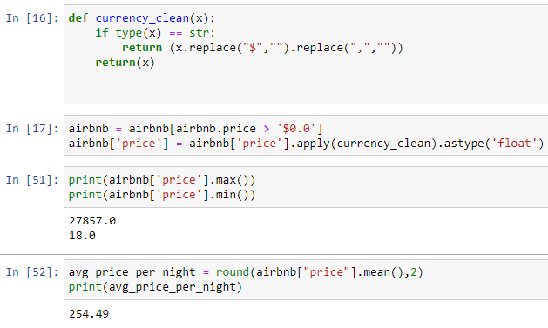
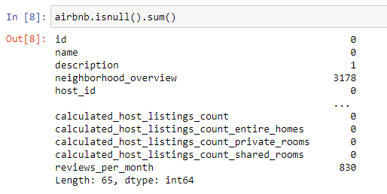
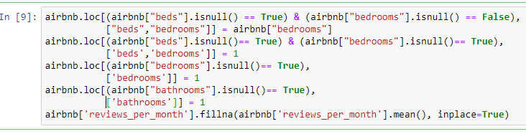
Code Snippets – Data Cleaning

Slide 6
Exploratory Data Analysis
Histograms were used to visualize the distribution of the target variable, price, and the features. This helped identify any outliers or skewed data that needed to be addressed.
We made a Distribution plot for normal distribution after doing the logarithm of whole price column when we found out from the histogram of price is positively skewed.
Correlation matrices were used to identify any linear relationships between the target variable and the features. This helped inform feature selection and engineering.

Slide 7
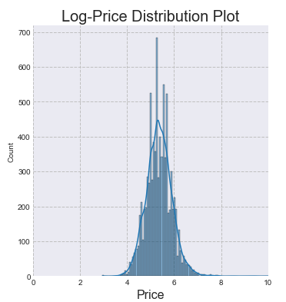
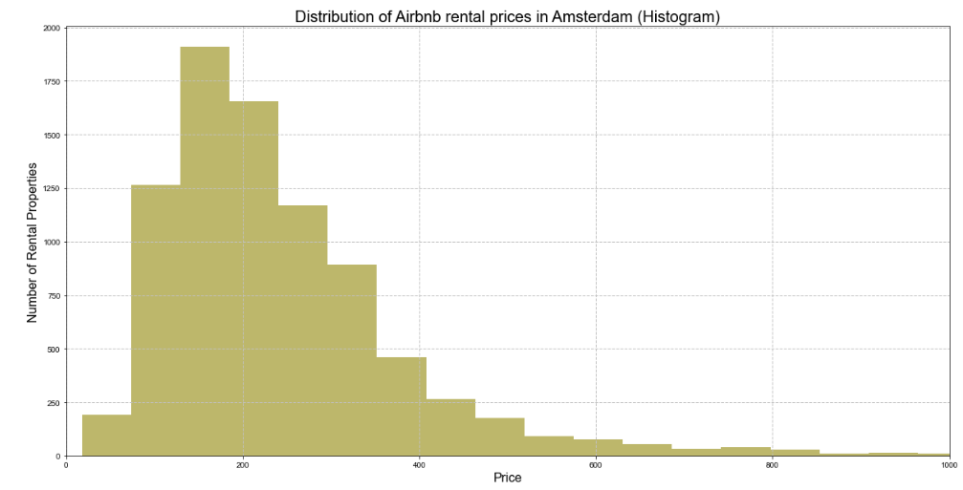
Histograms, Distribution Plot and Correlation Matrix

Slide 8
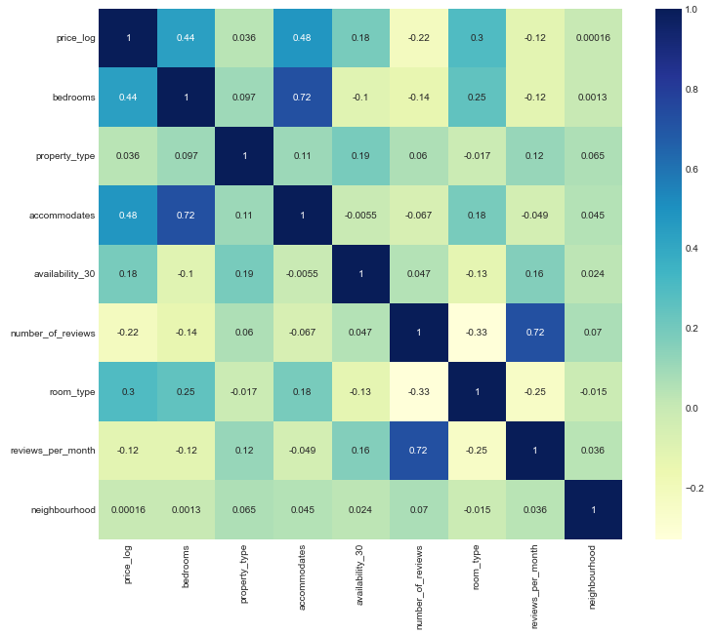
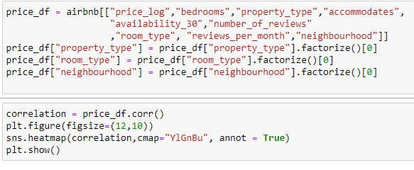
Histograms, Distribution Plot and Correlation Matrix

Slide 9
Feature Selection
After splitting the data into test and train dataset, we used extra tree classifier to figure out most important features in our model and plotted a bar graph for it.

Slide 10
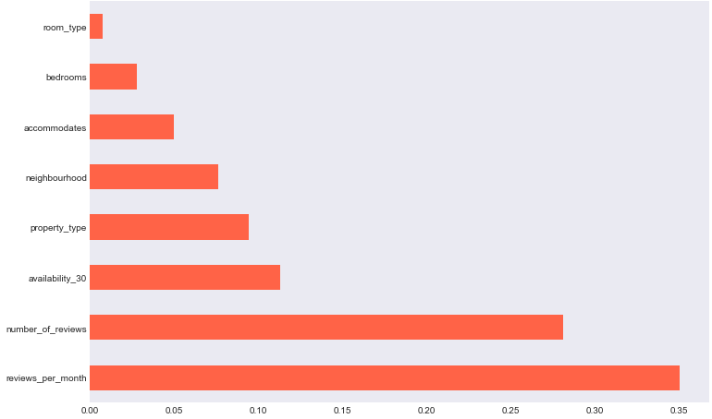
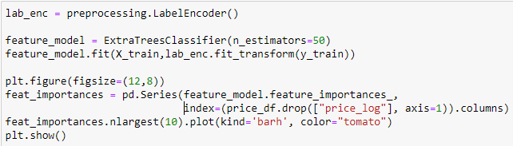
Feature Selection
Here, we are going to use ExtraTreesClassifier to find the most important features.

Slide 11
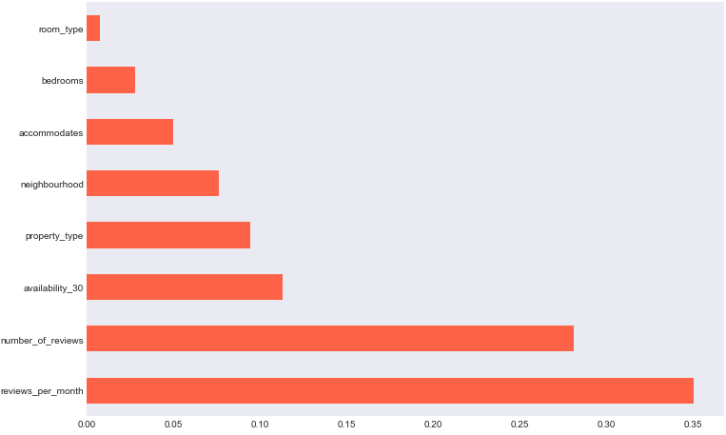
Feature Selection
The most important features are
Neighborhood
Property type
Number of reviews
Reviews per month
Availability_30

Slide 12
Model Selection and Evaluation
We evaluated several models including Linear Regression, Random Forest, and XGBoost. After comparing their performance metrics, we selected Linear Regression as the final model for its superior accuracy in this particular model and ability to handle non-linear relationships between features.
We used Mean Squared Error (MAE) and Root Mean Squared Error (RMSE) as our primary evaluation metrics. Additionally, we used R-squared (R2) to measure the proportion of variance in the target variable that is explained by the model.

Slide 13
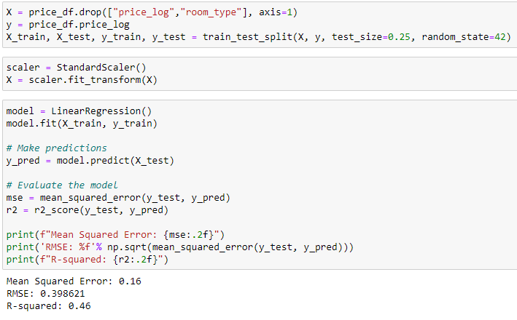
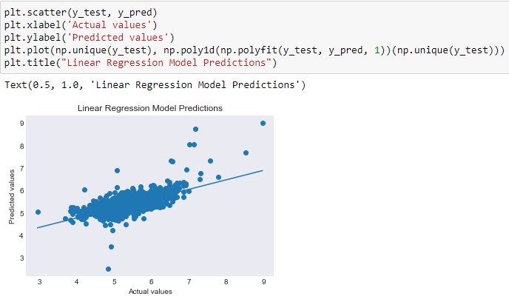
Code Snippets – Linear Regression

Slide 14
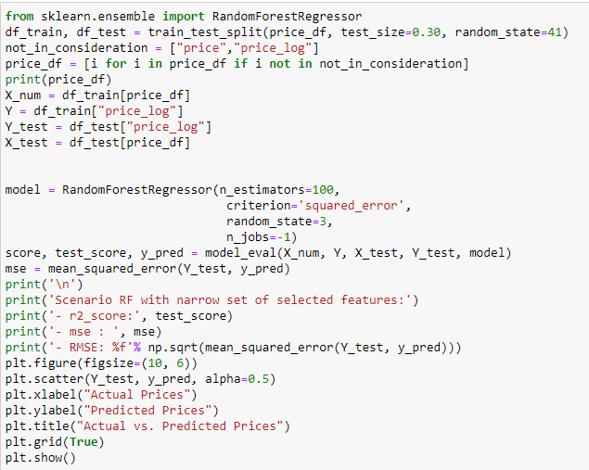
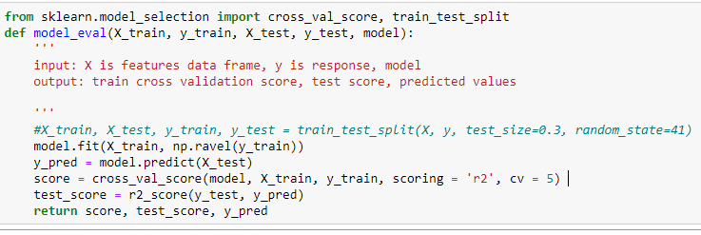
Code Snippets – Random Forests

Slide 15
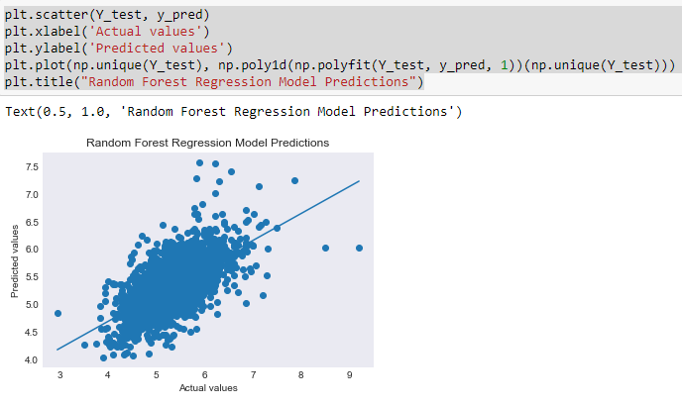
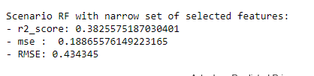
Code Snippets – Random Forests

Slide 16
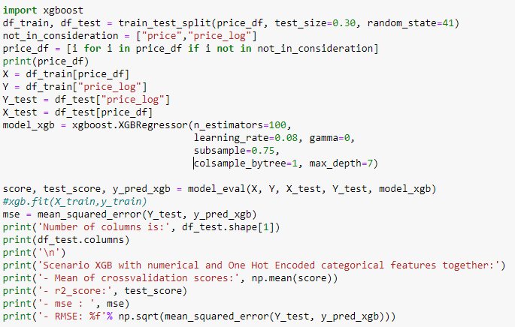
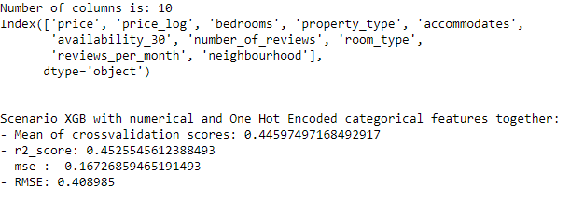
Code Snippets – XGBoost

Slide 17
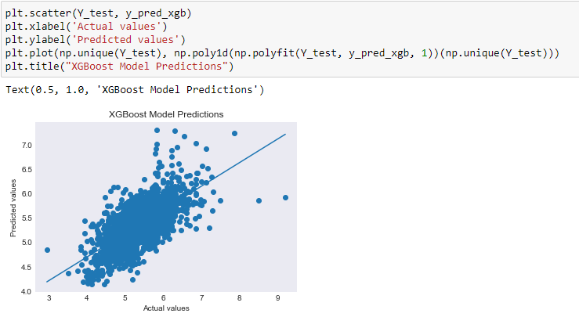
Code Snippets – XGBoost

Slide 18
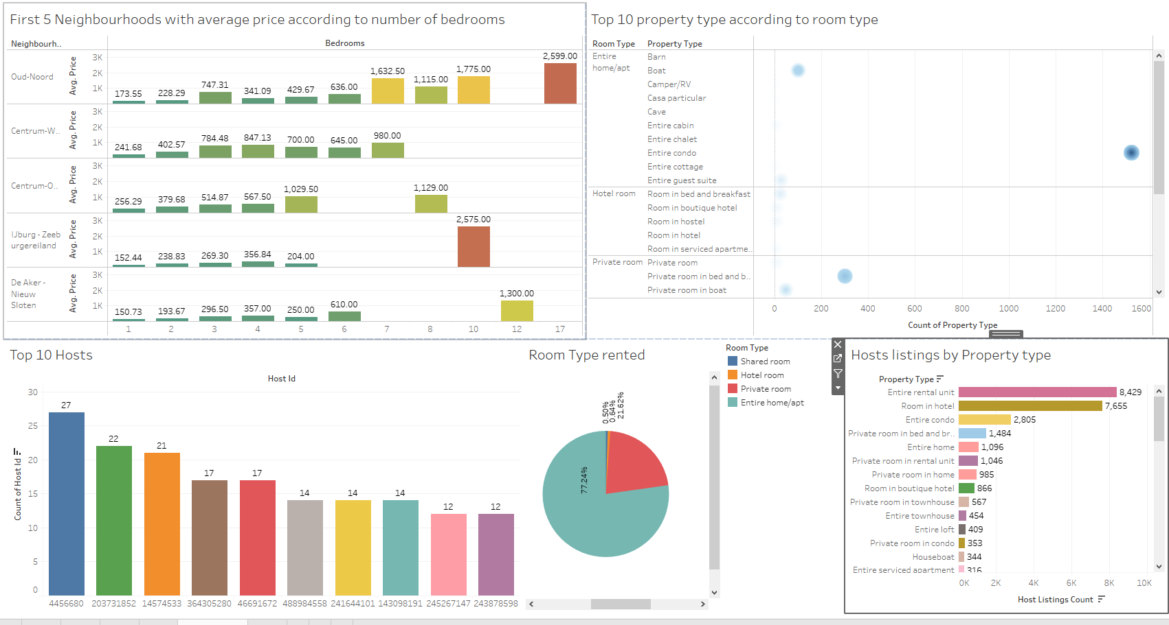
Dashboard for other visualizations using Tableau

Slide 19
Conclusion
Here, we had imported data and cleaned by using cleaning techniques followed by EDA and feature selection. After that we did some model selection and comparison we picked the best model.
Usually, XGBoost provides better accuracy but according to the features of this model, Linear regression turns out to be best with little but not least variations in its results.

Slide 20
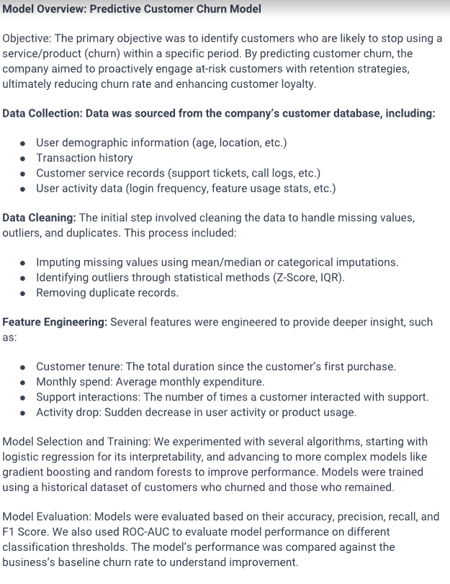
Other Works :
Predictive Customer Churn Model

Slide 21
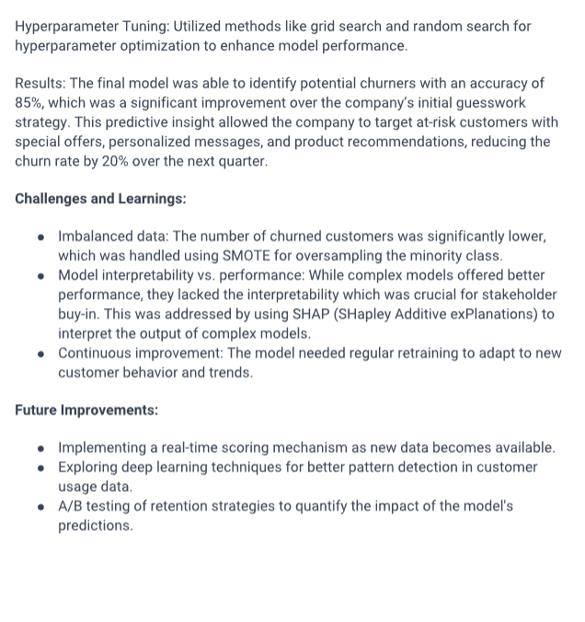
Other Works :
Predictive Customer Churn Model

